Slide 1
CP301(2020)-G2
Mentor Selection System
Gopesh Gaba(2020MCB1236)
Ashvin Sehgal(2020MCB1232)
Samual(2020MCB1249)

Slide 2
About us
We are 3rd Year BTech Students majoring in Mathematics and Computing.
In this Development Engineering Project we aim to use the skills we have gathered over the years to develop something for the betterment of our esteemed institution.

Slide 3

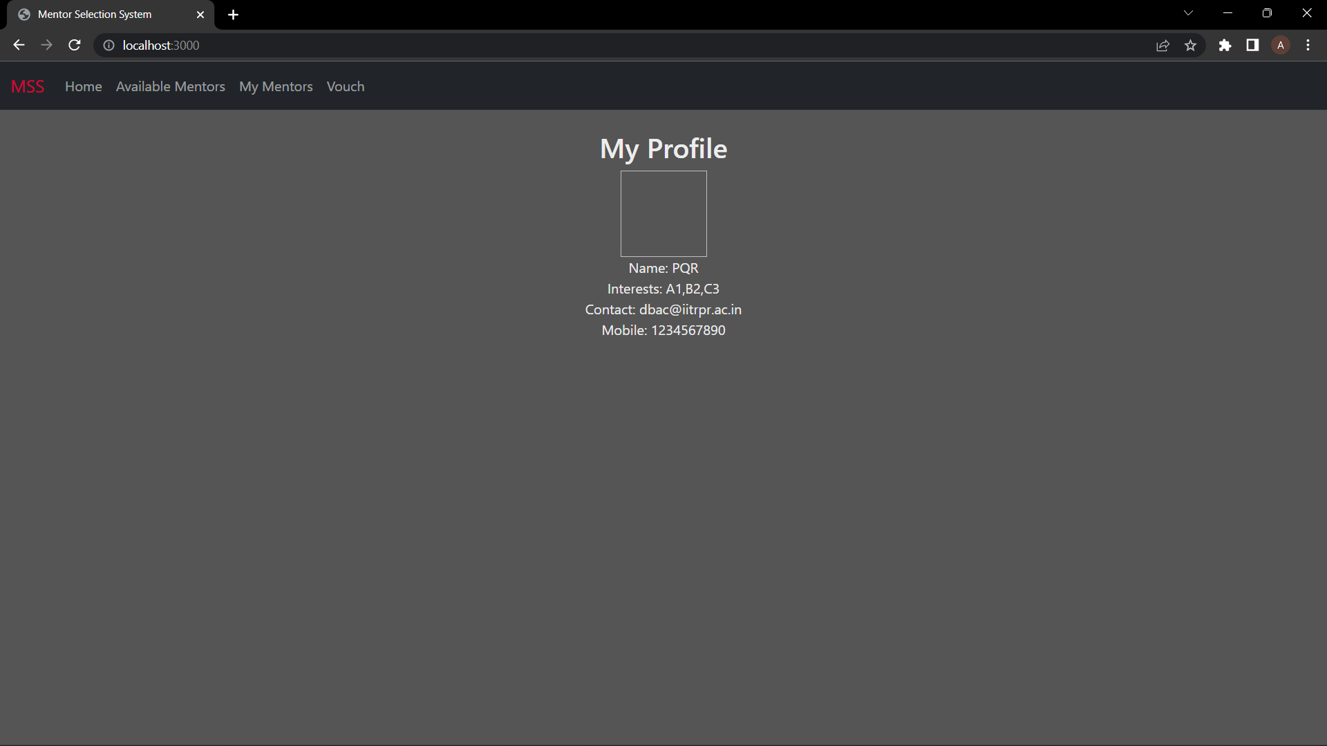
Mentor Selection System

Slide 4
Summary of the Presentation
Current System and its flaws
Here we will briefly describe the current system and its flaws
Our Idea
In this section we would describe the solution we are trying to develop that we believe will fix these flaws.
Implementation and Challenges
Here we will describe how we will implement our idea and the challenges we might encounter while doing this

Slide 5
Current System

Slide 6
Students in their Second Year volunteer for the position of Mentors.
The current ISMP secretary conducts interviews of the candidates.

Slide 7
It’s Flaws

Slide 8
In the past year, this system has faced a lot of criticism.
The current system is prone to partiality and favouritism.
Students treat mentorship as an easy POR to decorate their resumes.

Slide 9
The Need of the Hour

Slide 10
We need a system that-
facilitates inclusion and fairness.
increases inter year interaction.
provides freshers with a holistic view of the college and the opportunities within.
helps them lay a strong foundation for their college life.

Slide 11
An Idea

Slide 12
Our idea involves the freshers having 2 mentors.
One conventional mentor from 2nd Year.
And Second a super mentor from 3rd Year(in case of BTech).

Slide 13
Conventional Mentor System

Slide 14
Selection of mentors through vouch system.
Each second year student can vouch for at most one mentor candidate

Slide 15
Candidates with highest number of vouches become mentors.
ISMP council would settle ties in addition to holding veto power.

Slide 16
Salient Features
This system would lead to inclusion
Cliques favourable with seniors would not all become mentors.

Slide 17
Salient Features
Students would actually have to work towards collecting vouches.
Being able to get people to vouch for you is a direct indicator of a candidates networking skills.

Slide 18
Super Mentor System

Slide 19
This process of allocation of super mentors will take place after the conclusion of all sessions and competitions under ISMP.
The clubs would be required to maintain a record of the performance of freshers in these competitions.

Slide 20
This system involves the super mentor candidates(3rd yearites) making a profile filled with their achievements and experiences.
The Mentees would make a profile filled with their interests.

Slide 21
Then the Mentees would be given 5 days to review the profiles of super mentor candidates and give a preference order with their top 5 preferred candidates.
After that the super mentor candidates would conduct interviews to select their mentees.

Slide 22
Atleast 5 interviews to be conducted by super mentors every 2 days(if interviews pending).
Each super mentor can have at most 5 mentees.

Slide 23
If a mentee is rejected or his 1st preference super mentor becomes unavailable, his name would be automatically submitted to the next available super mentor according to his preference.

Slide 24
Salient Features
Provides Freshers with the view of the opportunities that are waiting for them.
Provides freshers with mentorship related to the field they want to excel in.

Slide 25
Salient Features
Would lead to increase in inter year interaction.
Would lead to increase in activity of various clubs.

Slide 26
Implementation

Slide 27
In order to implement the above described idea we need a portal that can simplify the above described process.
This portal should facilitate the vouch system, super mentor system etc.

Slide 28
In the super mentor system, we need to implement an “information filtering system” which would help the freshers to browse the profiles of mentors.
In addition, we will be implementing a forum for communication of mentors with other mentors and ISMP council, which would help in smoother communication.

Slide 29
Here are some samples of the portal we are working on

Slide 30
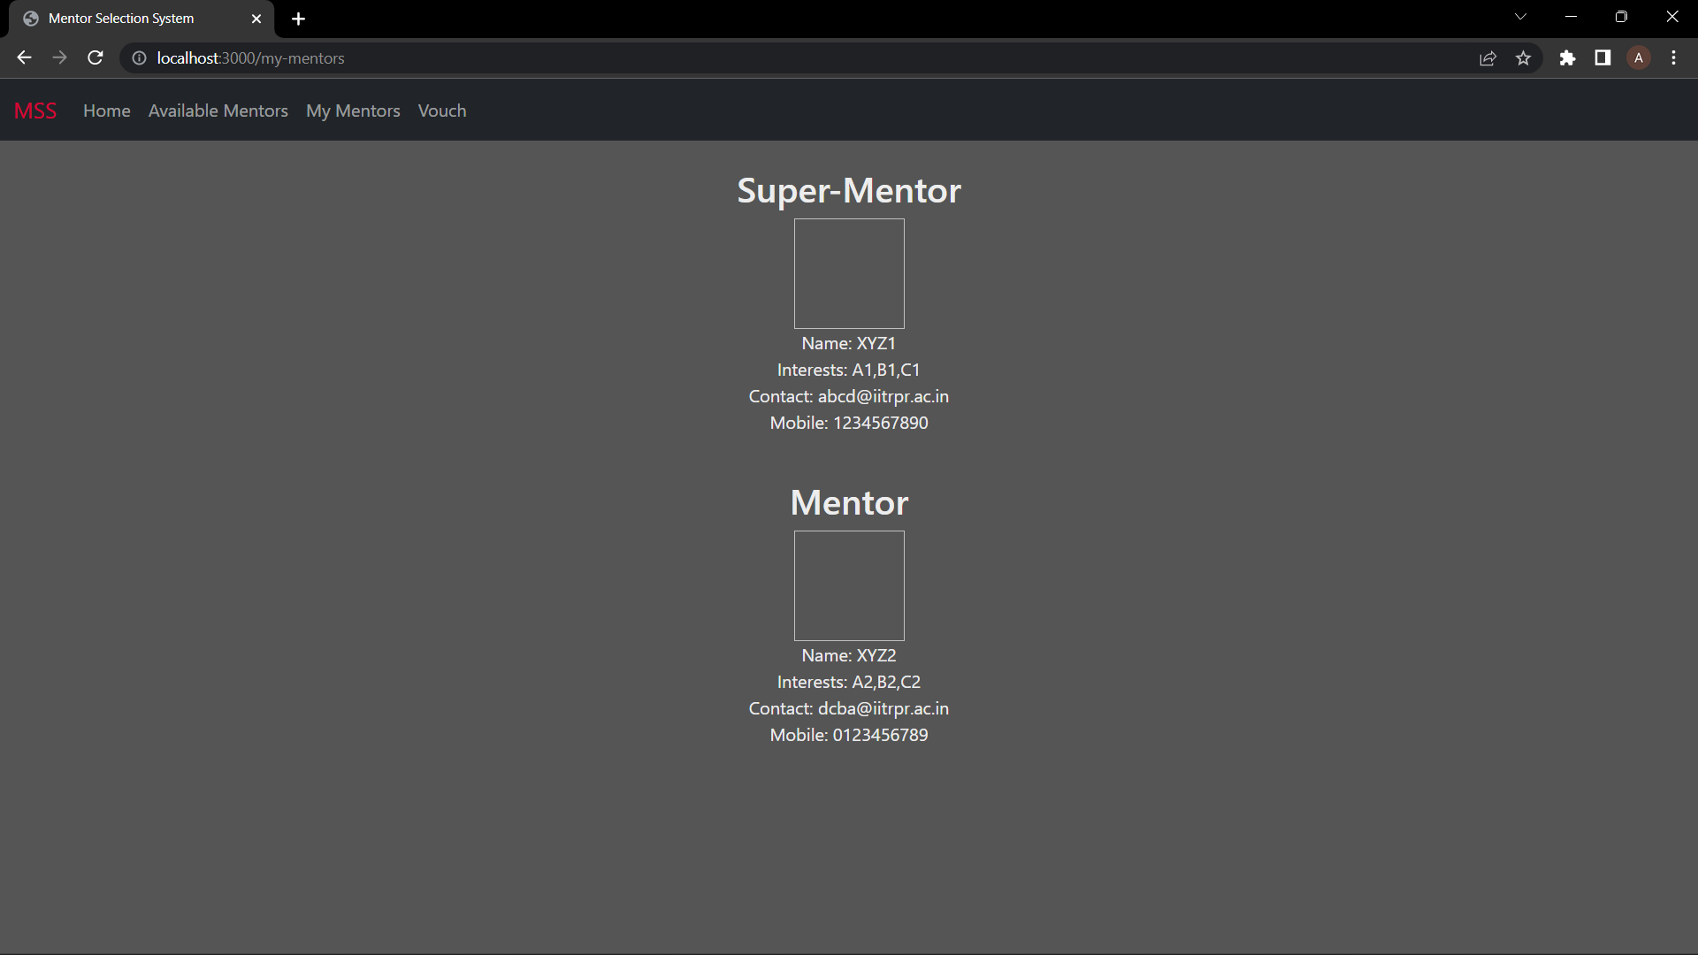
My Mentors
Shows the currently assigned mentors to the candidate for his/her reference.

Slide 31
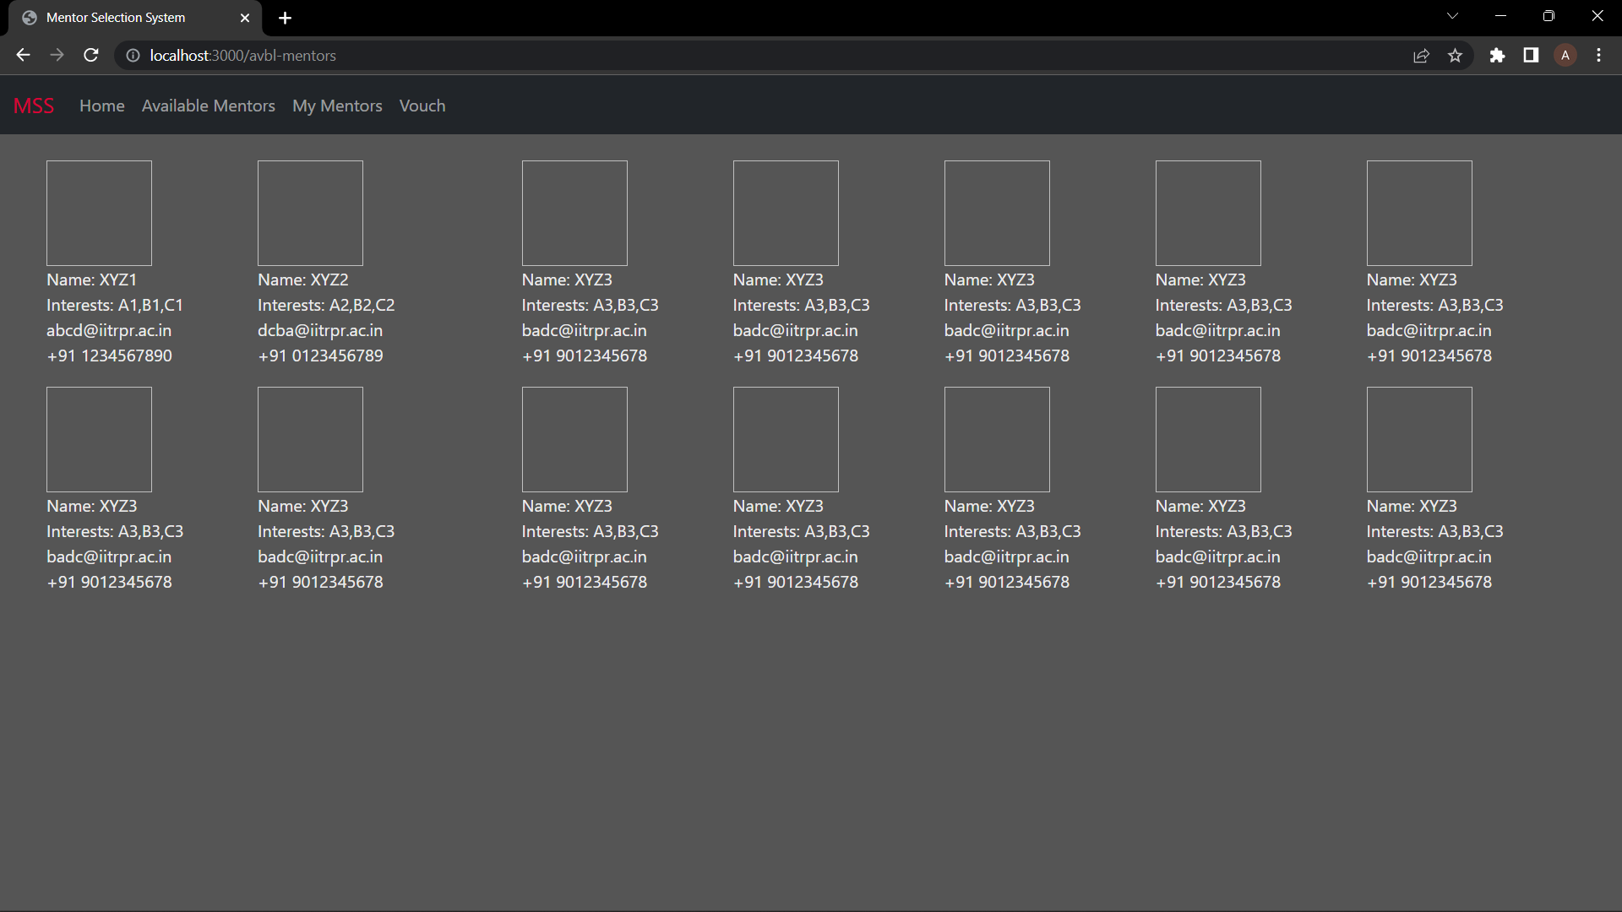
Available mentors
Shows list of all possible super mentor candidates and the mentee can then choose his preference order of mentors.

Slide 32
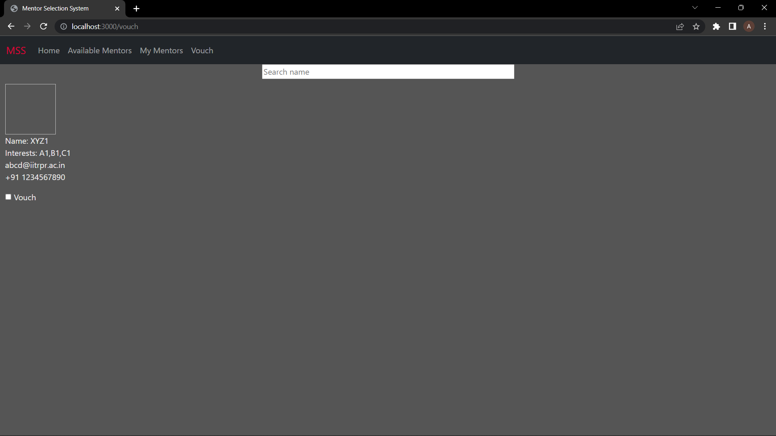
Vouch
Here,2nd year students can vouch for the one candidate who they think are worthy of becoming mentors.

Slide 33
Implementation Challenges

Slide 34
Participation of super mentors might not be up to the required number.
Vouch system is an indirect measure of a person’s skill as a mentor.

Slide 35
THANK YOU

